Slide 1
Project 3 : Cyberbullying on social media
Sarah LÉOUFFRE Ingrid MONDORI YONDO Maher ZEGHIDA

Slide 2
Original Dataset
5000 tweets from Turkey
27 columns
Various information such as number of followers or following, Emojis, number of words etc.

Slide 3
Main challenges
Cleaning outliers – judging which are outliers and what to drop/delete
Transfer directly from Python to MySQL
Understanding all the available data

Slide 4



Process
Check for all missing values and decide how to manage them (dropped, replaced by mean, replaced by 0, calculated)
Drop columns with repeating data
Search for duplicates

Slide 5



Process
Manage outliers
Connect Python to MySQL and export data
Insights

Slide 6
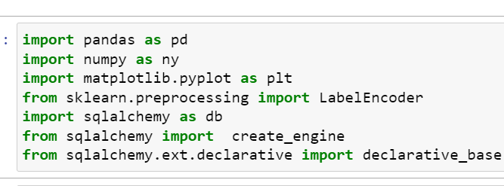
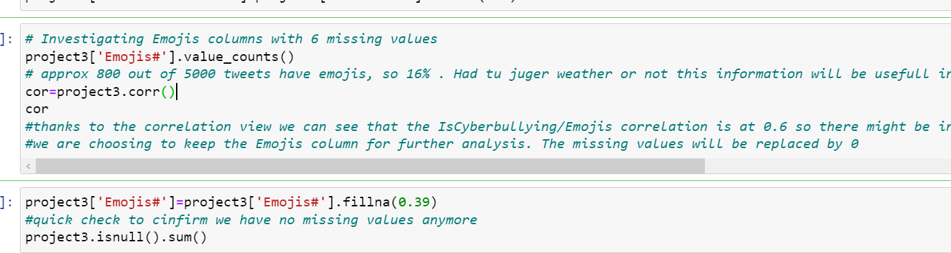
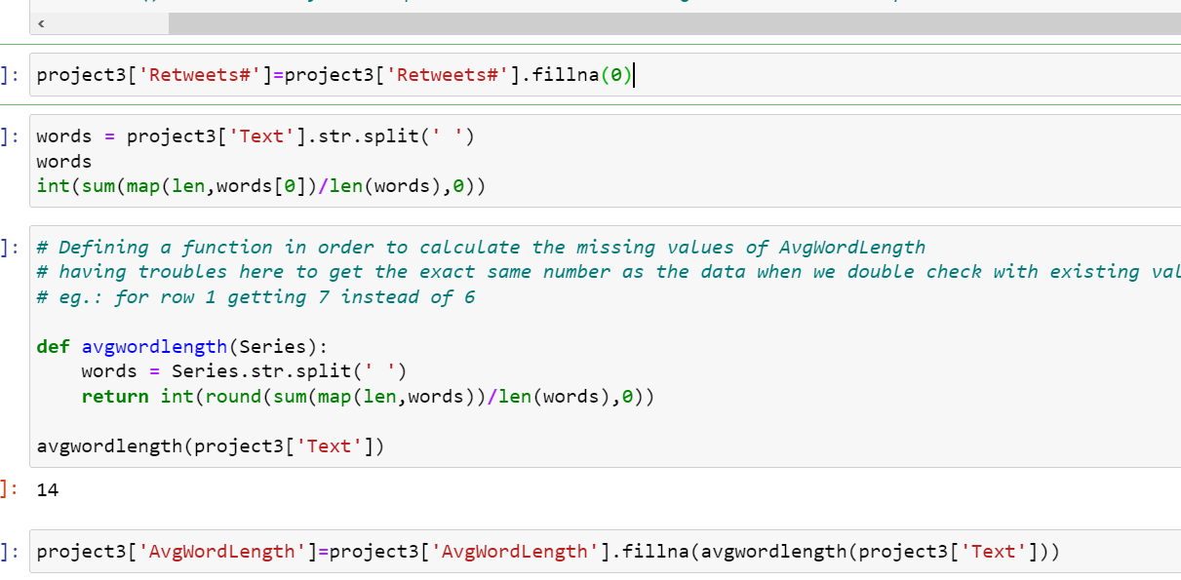
Demo
Module used
Manage missing data
Fonctions used for data prep

Slide 7
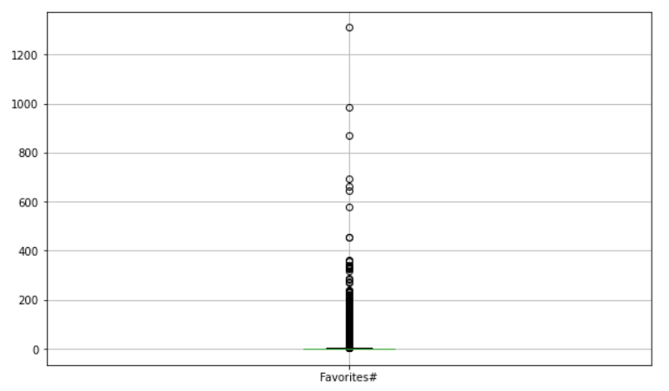
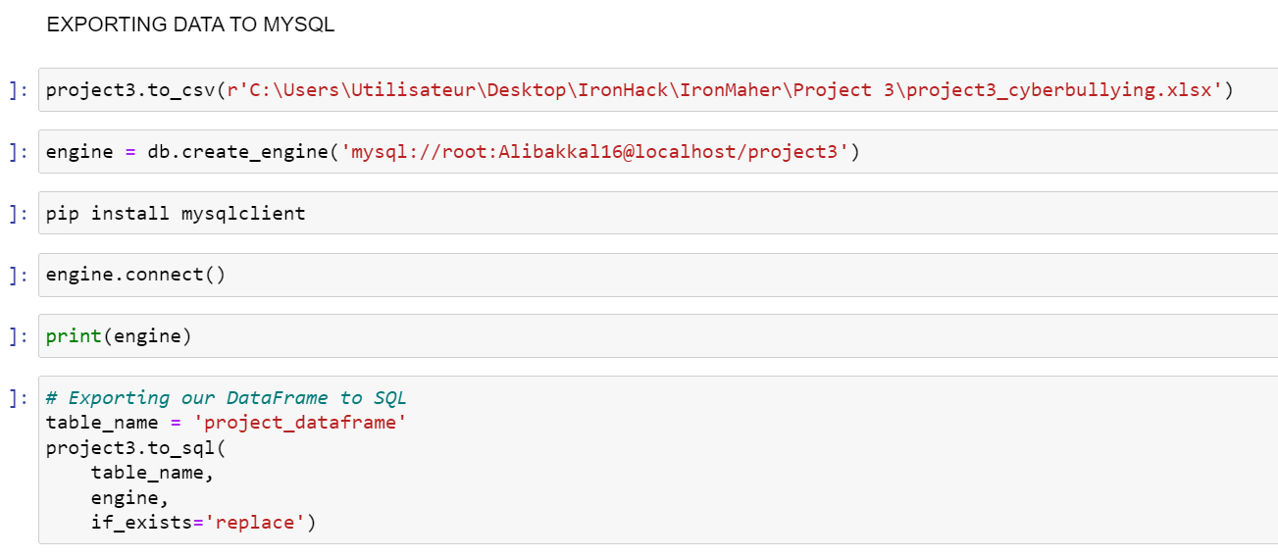
Demo
Outliers identification and management
Export data to sql

Slide 8
Final Dataset
5000 tweets
3513 tweets (rows)
16 columns
Needed information such as number of followers or following, number of words, average length word, etc.
27 columns
Various information

Slide 9
Questions ?

